Slide 1



SAVEETHA INSTITUTE OF MEDICAL AND TECHNICAL SCIENCES CHENNAI - 602105
Artificial Intelligence for Network Traffic Management
PRESENTED BY
NITHEESH S
192524329
Guided by: Dr. R. Shankar

Slide 2


INTRODUCTION
Network traffic management controls the flow of data in a network.
Traditional methods may struggle with heavy traffic and sudden congestion.
Artificial Intelligence (AI) helps monitor, analyze, and manage network traffic intelligently.
AI improves network performance and reduces delays.

Slide 3

Role of AI in Network Traffic Management
AI analyzes real-time network traffic data.
It detects congestion, unusual traffic, and network failures.
Machine Learning (ML) can predict future traffic patterns.
AI automatically makes decisions to optimize data flow.

Slide 4

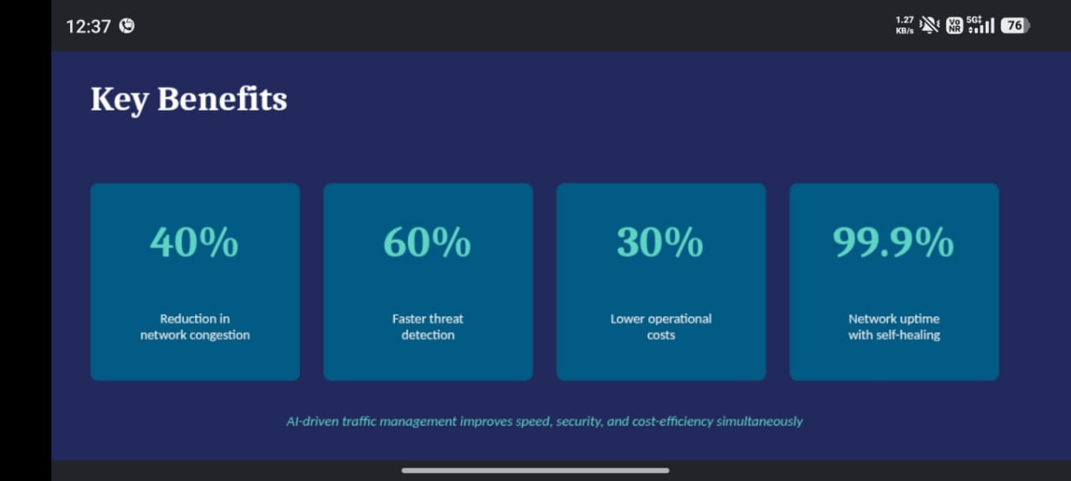
Benefits
11/14/2025
7

Slide 5
Conclusion
AI provides intelligent and automated network traffic management.
It helps networks become faster, more reliable, and secure.
AI-based systems can predict problems before they occur.
In the future, AI will play an important role in managing large and complex networks.

Slide 6
THANK YOU

